Slide 1

‘From Seeds to Specimens’
What size suits you best?
Welcome everyone
Session 1
What influences Specifications?
20 March 2019

Slide 2

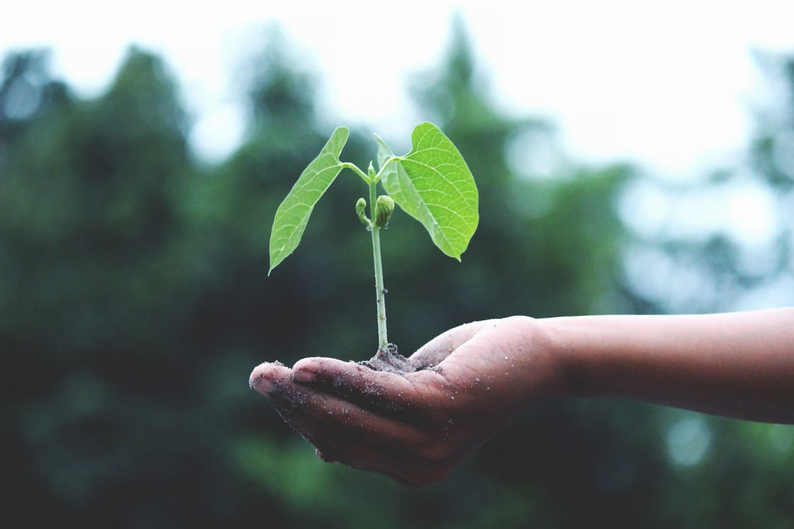
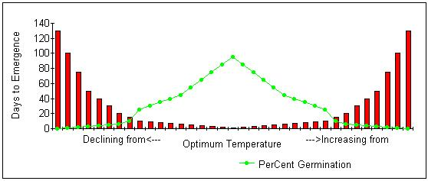
From seed
To get the best, we need to respect the environment and understand restrictions
20 March 2019

Slide 3
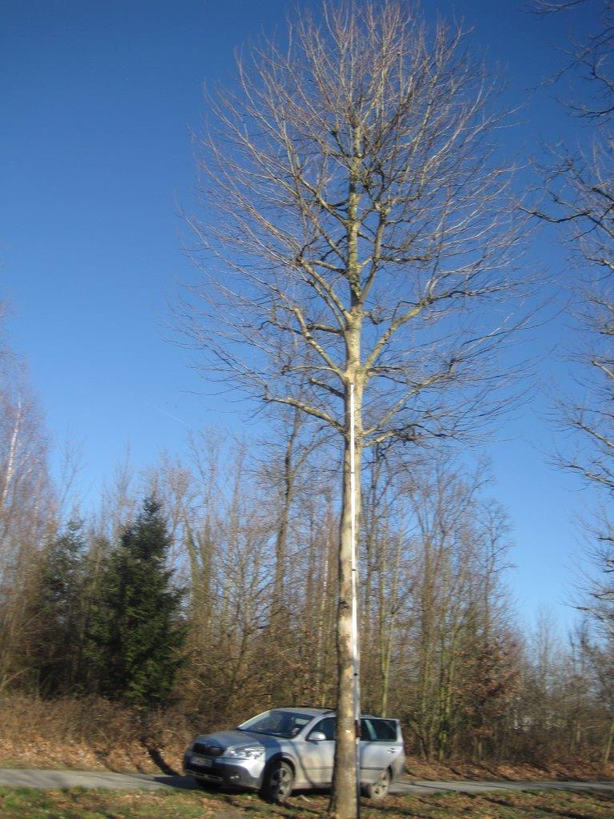
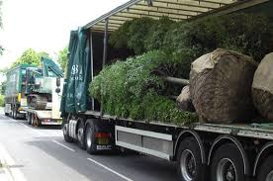
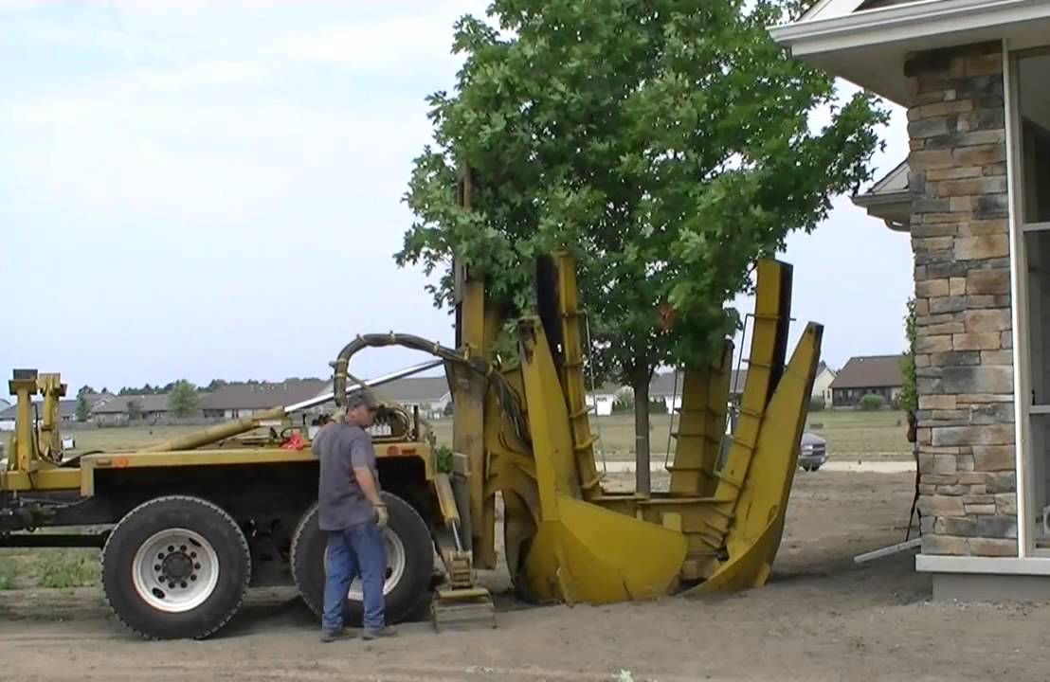
To specimens
What can we achieve with planning?
20 March 2019

Slide 4
A bit of preparation
In the spirit of planning
Session 2
Inside the factory
We will be joined for a Q&A session to explore what the factory can do for you
Geoff – Designer Sales Manager
Martin – Production Manager
So you can start formulating your thoughts for questions…
20 March 2019

Slide 5



Factors we can influence
Some thoughts:
Access
Aspirations & expectations
Availability
Budget
Lead times
Local environment
Planting seasons
Specification
Terms & Conditions
We can influence a number of factors, but…
20 March 2019

Slide 6
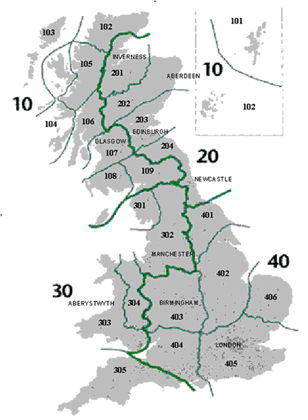
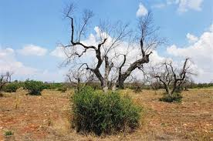

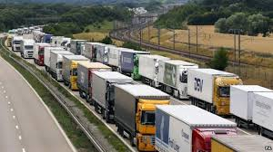
…..some we can not
Our thoughts:
Biosecurity
Movement restrictions
Planning restrictions
Provenance
Quarantine
Soils & services
Space
Trading terms (Brexit)
How we can work together………
20 March 2019

Slide 7
Working together
An example
PALMSTEAD NURSERIES LTD: BIOSECURITY POLICY
As importers of plant stock, Palmstead Nurseries Ltd (PNL) recognise our responsibility to protect the environment from known and future threats from pests and diseases.
Our policy is designed to be flexible, easy to revise when circumstances change and will be reviewed annually. The policy is designed to be inclusive of our clients, suppliers and industry partners.
Palmstead Nurseries Ltd will: …………….
Setting out measurable outcomes
– the RAG system
20 March 2019

Slide 8
What do we expect from the pot spec?
Pot and plant sizes have been defined by the National Plant Specification. Using a range of sizes, the design can provide impact and maturity to a planting scheme within budgets. Does the pot size influence plant size?
Common pot sizes used in specifications
9 cm - Bulbs, spring planting of herbaceous, aquatics
2/3 litre - Ideal for bulk and drift planting
5 litre - Increasing popularity replacing some 2/3 litre lines
10 litre - Provides impact/structure in larger numbers
15 litre - Intermediate size offering specimens on a budget
25 litre - The large plant providing focal points
Specimens - Providing maturity to the scheme
20 March 2019

Slide 9
Other forms?
Container production represents the traditional form to to plant throughout the year. However, other forms are available:
Air pots 12 months
Bio-degradable 12 months (planning planting windows)
Co-co wrap 12 months
Open Ground/Bareroot/roots November - March
Plugs 12 months (restrictions by number/type)
Rootballs November - April
20 March 2019

Slide 10
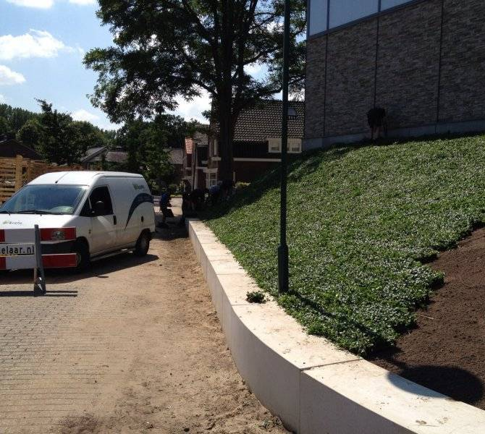
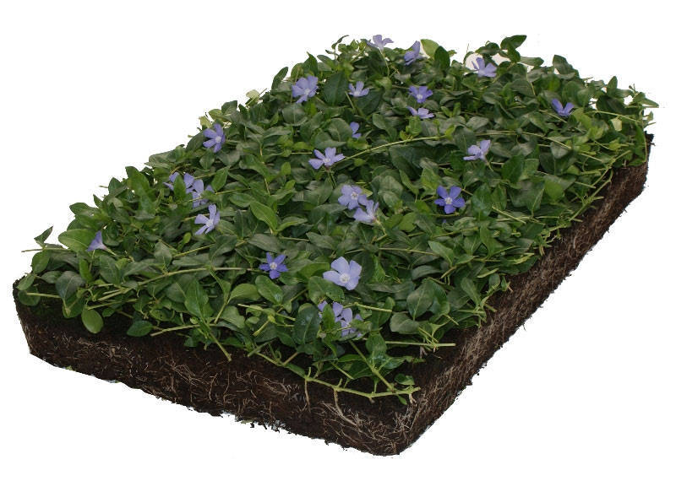
But what can we do?
With time on our side planning can help to meet the spirit of the design, delivering aspirations within budgets with realistic and deliverable outcomes taking account of the client’s instruction.
What size? Some thoughts:
Labour costs
Visible gaps in the event of a plant failure
Material cost
Rootmat development for stabilisation
Soil preparation and planting
Number/m² – remove the pin cushion effect
Transportation - controlling emissions and costs
Waste management
Challenging convention
How can you apply innovation to your schemes?
20 March 2019

Slide 11
‘From Seeds to Specimens’
What size suits you best?
Session 2
Inside the factory
Welcome Geoff & Martin
20 March 2019

Slide 12
Everything is possible
‘The impossible just takes longer’
‘There is nothing you can’t do, if you set your mind to it’
‘Anything is possible if you put your heart and mind to the task’
‘If we're clever enough, smart enough, work hard enough’
‘When you throw everything up in the air, anything becomes possible’
‘Understand to achieve anything requires faith and belief in yourself, vision, hard work, determination, and dedication’
Working with others delivers vision, given time. We do not grow cans of beans…
20 March 2019

Slide 13

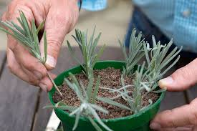
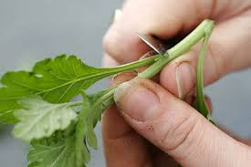
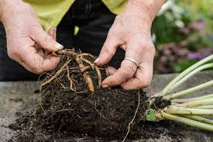
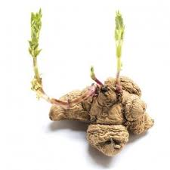
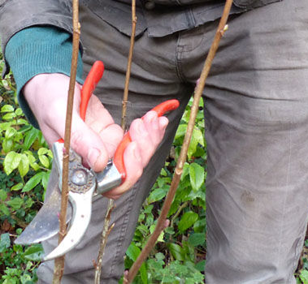
Setting out timelines
Jan
Feb
Mar
Apr
May
Jun
Jul
Aug
Sep
Oct
Nov
Dec
Whether sowing seeds or propagating by direct sticking, tubers, softwood cuttings, hardwood, root division or cuttings, by using seed or plug trays there is a time for everything.
20 March 2019

Slide 14
The clock starts ticking
Jan
Feb
Mar
Apr
May
Jun
Jul
Aug
Sep
Oct
Nov
Dec
The timelines are dependent on the genus and species; some plants irrespective of the pot size we aim for cannot be forced, for example Sarcococca.
20 March 2019

Slide 15
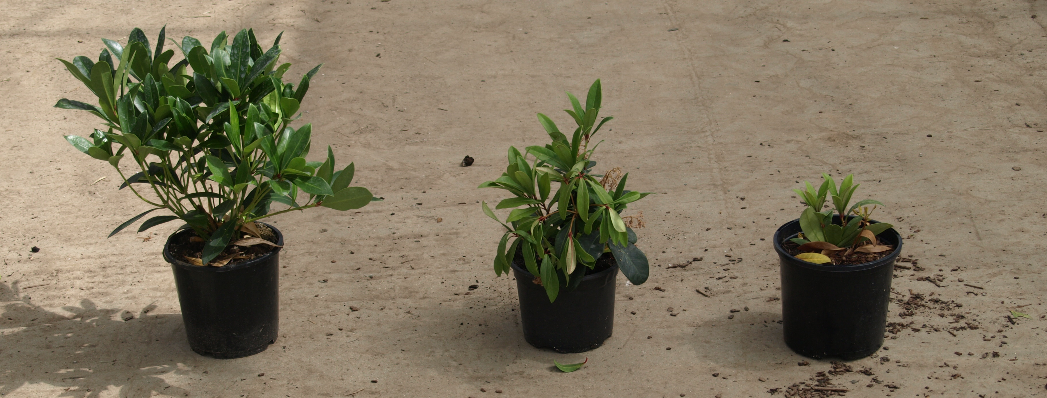
Plants do not always behave
How do we manage plant performance/failure
Applying a selection criteria
Batch control
Overgrow
Time
20 March 2019

Slide 16
Planting densities
A practicable application
How many to the square metre
A visual impression of planting densities set out at Palmstead Plants
Can we use standardised numbers/m² or do we need to understand the habit of the plant?
20 March 2019

Slide 17
‘From Seeds to Specimens’
What size suits you best?
Session 3
Walkabout – 1 hour
20 March 2019

Slide 18
‘From Seeds to Specimens’
What size suits you best?
Session 4
Value engineering
Balancing budgets and expectations
20 March 2019

Slide 19
Case study 1
20 March 2019

Slide 20
Case study 1
Back to the tree
20 March 2019

Slide 21
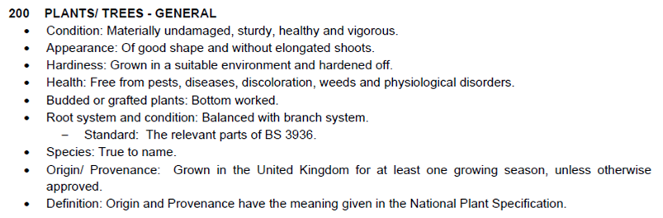
Case study 2
Grown on the nursery?
The National Plant Specification:
Origin – ‘The place in which indigenous plants are grown or the place from which non-indigenous plants were originally introduced’
Provenance – ‘The place in which any plant, whether indigenous or non- indigenous, is growing’
Country of Origin – ‘The country where the plant has been growing for the latter half of the most recent growing season’
‘It is not appropriate to specify particular origin/provenance speculatively, establishing origin is a complex issue’
20 March 2019

Slide 22
Case study 2
Description | Type | Form | Size | Spread | Order Qty
Ajuga reptans | Regular | 1 litre | --- | --- | 215
Ajuga reptans 'Catlin's Giant' | Regular | 1 litre | --- | --- | 198
Alchemilla mollis | Regular | 1 litre | --- | --- | 108
Euonymus europaeus | Regular | 3 litre | 40-60 cm | --- | 52
Euphorbia amygdaloides | Regular | 1 litre | --- | --- | 413
Frangula alnus | Regular | 3 litre | 40-60 cm | --- | 36
Geranium sylvaticum | Regular | 1 litre | --- | --- | 413
Hedera helix | Regular | 2 litre | 30-40 cm | --- | 625
Hedera helix | Regular | 1 litre | --- | --- | 306
Ilex aquifolium | Regular | 3 litre | 40-60 cm | --- | 36
Ligustrum vulgare | Regular | 5 litre | 40-60 cm | --- | 68
Liriope muscari | Regular | 2 litre | --- | --- | 163
Liriope muscari | Regular | 3 litre | --- | --- | 110
Lonicera periclymenum | Regular | 5 litre | 40-60 cm | --- | 36
Prunus spinosa | Regular | 5 litre | 40-60 cm | --- | 70
Rhamnus cathartica | Regular | 5 litre | 40-60 cm | --- | 102
Rosa arvensis | Regular | 5 litre | 40-60 cm | --- | 102
Sambucus nigra | Regular | 5 litre | 40-60 cm | --- | 52
Tiarella 'Spring Symphony' ® | Regular | 1 litre | --- | --- | 108
Tiarella 'Spring Symphony' ® | Regular | 2 litre | --- | --- | 114
Viburnum opulus | Regular | 5 litre | 40-60 cm | --- | 68
How do we assess the ability of the grower to meet the instruction of the client, delivering specification without specified timelines or project details?
1 litre plants will potentially exhaust the growing media inside 12 months.
20 March 2019

Slide 23
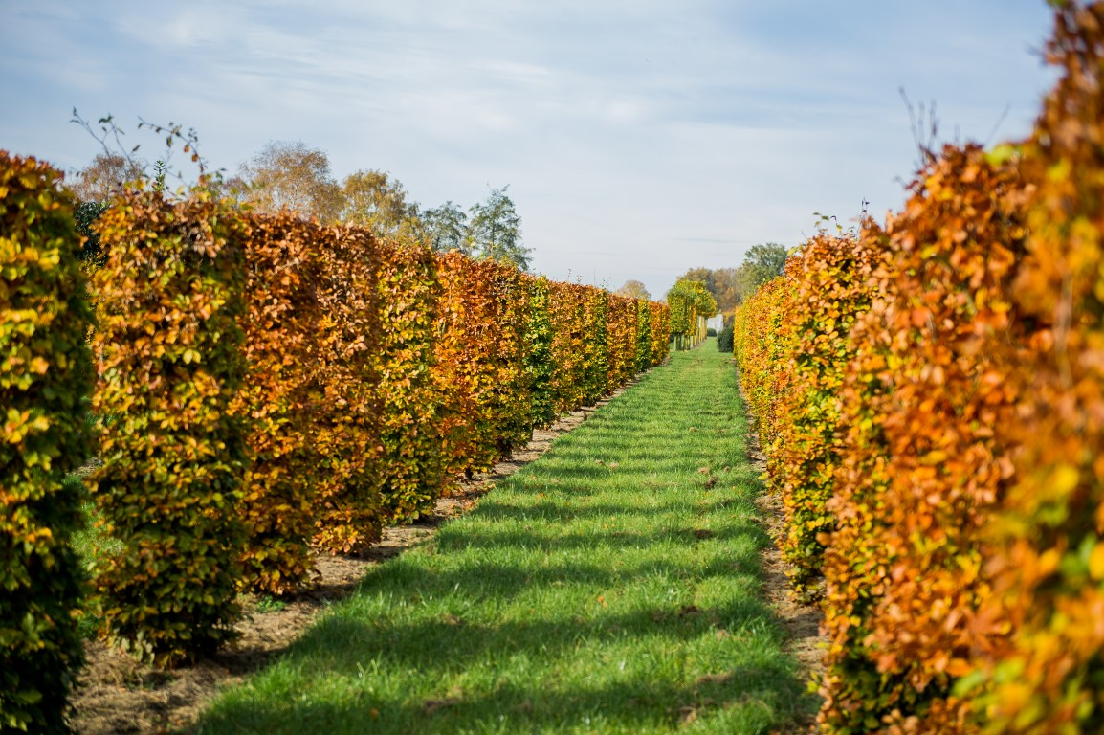
Case study 2
Description | Type | Form | Size | Spread | Order Qty
Agapanthus africanus | Regular | 3 litre | --- | --- | 639
Anemone x hybrida 'Honorine Jobert' | Regular | 3 litre | --- | --- | 571
Astilbe x arendsii 'Brautschleier' White | Regular | 2 litre | --- | --- | 340
Astrantia major 'Large White' | Regular | 2 litre | --- | --- | 320
Carex elata 'Aurea' | Regular | 3 litre | --- | --- | 358
Deschampsia cespitosa 'Goldtau' | Regular | 3 litre | --- | --- | 1123
Dryopteris affinis 'Cristata' | Regular | 2 litre | --- | --- | 491
Epilobium angustifolium 'Album' | Regular | 2 litre | --- | --- | 344
Erigeron karvinskianus | Regular | 2 litre | --- | --- | 675
Pachysandra terminalis | Regular | 2 litre | --- | --- | 1120
Pennisetum alopecuroides 'Hameln' | Regular | 3 litre | --- | --- | 510
Pennisetum x advena 'Rubrum' | Regular | 2 litre | --- | --- | 794
Perovskia atriplicifolia 'Blue Spire' | Regular | 2 litre | --- | --- | 479
Persicaria bistorta 'Superba' | Regular | 2 litre | --- | --- | 362
Pittosporum tenuifolium 'Tom Thumb' | Regular | 5 litre | 30-40 cm | --- | 257
Salvia nemorosa 'Caradonna' | Regular | 2 litre | --- | --- | 662
Salvia x sylvestris 'Dear Anja' | Regular | 2 litre | --- | --- | 372
Sesleria autumnalis | Regular | 2 litre | --- | --- | 265
Verbena bonariensis | Regular | 3 litre | --- | --- | 815
Veronicastrum virginicum | Regular | 2 litre | --- | --- | 379
Viburnum davidii | Regular | 5 litre | 30-40 cm | --- | 308
Where provenance/quarantine periods are specified, the number of units required can influence whether we use contract grow to protect the scheme, or influence when we bring items into stock to meet quarantine provisions.
20 March 2019

Slide 24
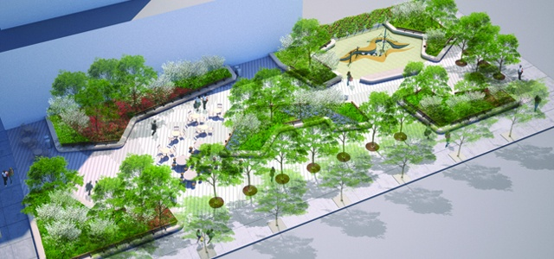
Case study 3
Protecting the vision – What do we need to plan for?
Access/restrictions
Colour palettes
Specimens
Trees
Volume
20 March 2019

Slide 25
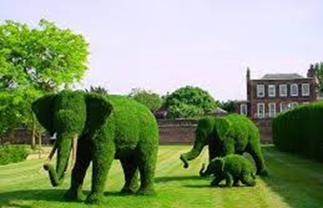
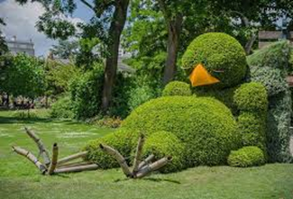
Communication
Contract grows vs responsive supply
What do we need to specify to ensure we can work with the client’s specifications and expectations?
Working together we can value engineer; this is not always about reducing sizes, but working with the grower’s existing production process
How can we communicate with clarity?
A picture speaks a thousand words
20 March 2019

Slide 26
‘From Seeds to Specimens’
What size suits you best?
Meet the Team Q & A
20 March 2019

Slide 27
Thank you for coming to
‘From Seeds to Specimens’
What’s next?
'Planting for drought’
24 April 2019
www.palmstead.co.uk
20 March 2019

Slide 28
'Planting for drought'
24 April 2019
We will cover some of the following:
  Characteristics of a drought tolerant plant
  A selection of plants
  Site preparation and soil conditioners
  Harvesting ‘grey water’
  Water retention and irrigation
  Some practicable applications to reduce water consumption
  Looking after your designs by informing our clients
www.palmstead.co.uk
20 March 2019

